Slide 1
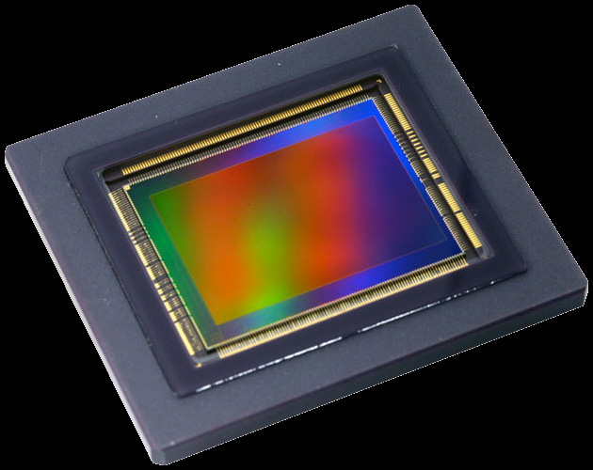
Capstone
Image Sensor Defect Detection
Theleeban Ragunathan

Slide 2
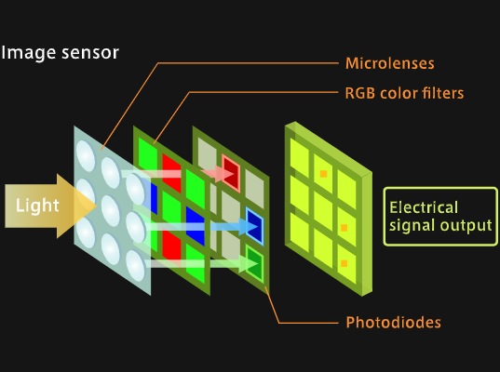
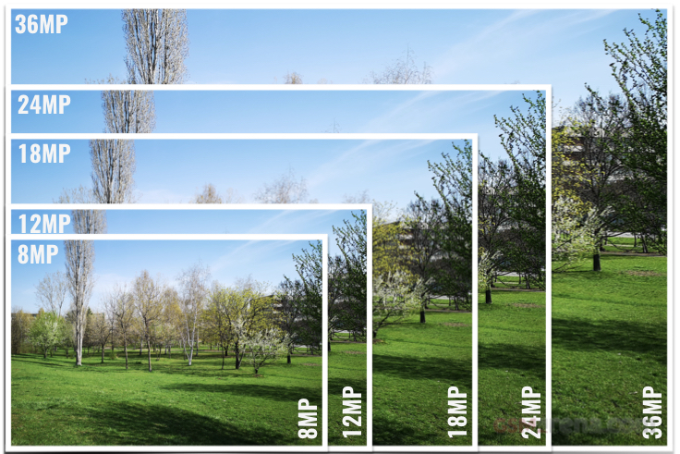
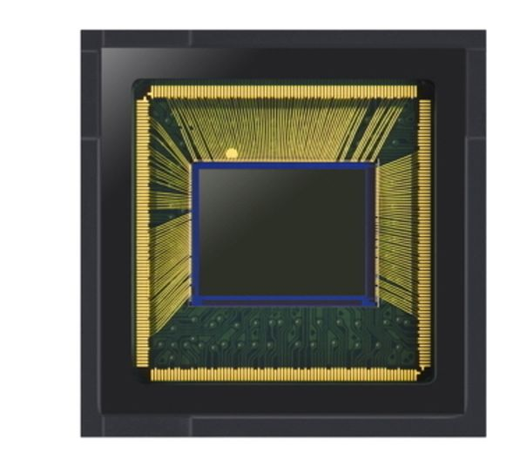
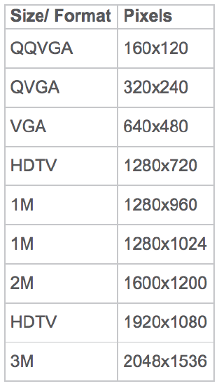
Image Sensor Basics
Image Sensor Single Pixel

Slide 3
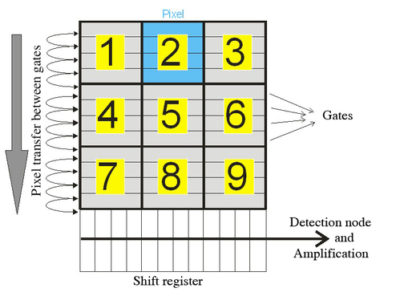
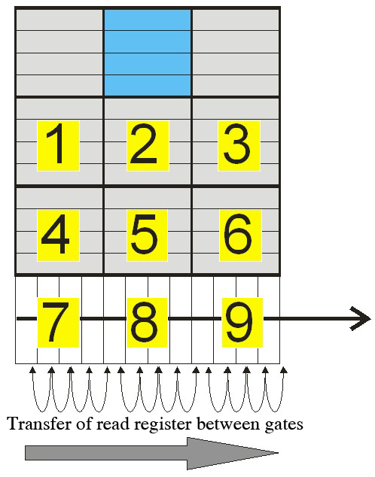
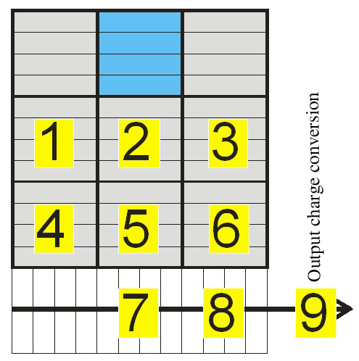
Image Sensor Basics

Slide 4
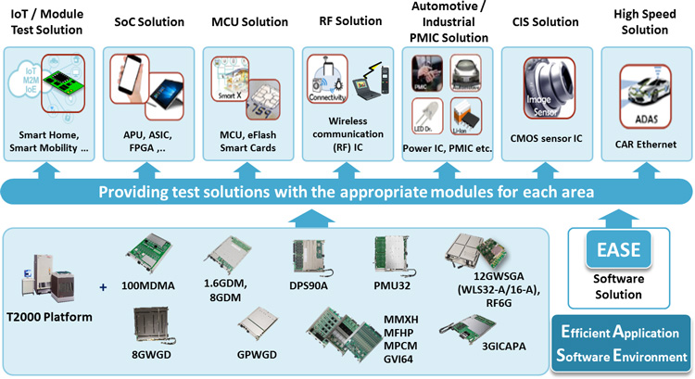
Semiconductor Products Testing
Automated Test Environment are used to test every semiconductor products reaching consumers. ATEs and testing phase are very expensive chip makers for ways to cut cost at every turn. Up front cost to setup test floor is very high each ATE could cost in millions depends on the configuration, let alone the operating cost.

Slide 5
Brief Introduction
During Image sensor manufacturing phase, sensors has to go through testing process to ensure the quality and reliability. There are many strict control work flows introduced by various teams involved minimise, eliminate or track quality compromising scenarios.
Control work flow for suOne of the scenario is that testing process yield for certain batch of products falling below the estimated yield.ch scenario is that a trained production staff should check each sensor data (image) visually and categorise each data (image) to trained categories (total of 8 categories). Categories are based on the defect pattern observed.

Slide 6
Problem Statement
Manual image checking work flow by human eye is time consuming and error prone. Each sitting a staff may need to visually check between 3000 to 4000 images and categorise them. Staffs are subject to suffering from fatigue and unsatisfactory of the nature of the task.
Observed that conducting such work flow during night shift results in staff couldn’t able to complete the task before the shift end due to eyes getting tired and feeling sleepy. Result is an unreliable work flow causes delay in daily product output delivery to customer.
Scope Of The Project
Build a reliable system to replace the manual image checking work flow.

Slide 7
Data and Categories

Slide 8

Category 1 (Good)

Slide 9

Category 2 (Dead pixel)

Slide 10

Category 3 (Die defect)

Slide 11

Category 4 (Dust/Stain on glass)

Slide 12

Category 5 (Test interface shading)

Slide 13

Category 6 (Ring stain)

Slide 14

Defect Category 7 (Shift register failure)

Slide 15

Category 8 (Test light source out of focus)

Slide 16
Timeline
 | Week 1 | Week 2 | Week 3 | Week 4
Feature Engineering
Modelling
Deployment
Testing and optimizing

Slide 17
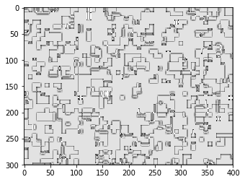
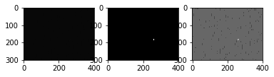
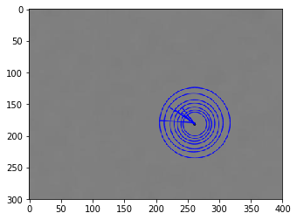
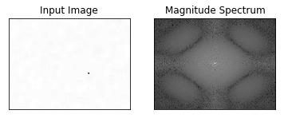
Feature extraction
HD Image size is 1280 x 720 pixels, which means 921 600 features.
Minimum number of defect could be as little as 1 out of 921 600.
Question asked to find features and reduce dimension: How to represent an image properties by functions(equations)?
Local binary patterns (LBP)
Gabor filter
Key points feature
Fast Fourier Transform

Slide 18
Model Scores
 | Accuracy | ROC Score
Logistic Regression | 97.06% | 98.317%
KN Neighbour Classifier | 99.65% | 99.802%
Decision Tree Classifier | 99.64% | 99.794%
Random Forrest Classifier | 99.88% | 99.929%
Extra Tree Classifier | 99.89% | 99.937%
Support Vector Machines | 99.74% | 99.849%

